Slide 1
GENERATORS
A generator is a machine that converts mechanical energy into electrical energy by the process of electromagnetic induction
They are driven by the engine(s), and sometimes by APU.
A generator must be rated at adequate amperage to drive all the operating components on its circuit(s). The current required to operate each electrical component is known as its load.

Slide 2
All generators produce alternating current naturally.The method which is used to take it from the coil will determine if the generator provides ac or dc to the circuit.
If a commutator is used for this purpose it will be a dc generator.
If a slip ring is used it will be an ac generator.

Slide 3
DC GENERATORS:
Commutator in the generator converts the ac current to dc current.
DC generator is designed to supply nearly constant voltage. Usually the voltage is 28vdc, but there are 270vdc systems developed recently.
They supply current up to 400 A.
Most aircraft do not have a separate dc generator, but ac produced by ac generator is converted to dc to power dc systems.

Slide 4
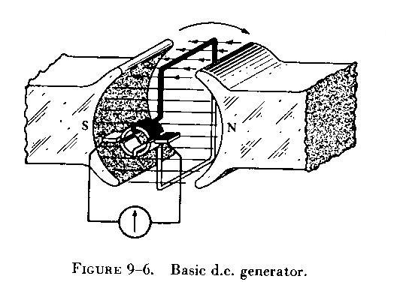
Basic dc generator

Slide 5
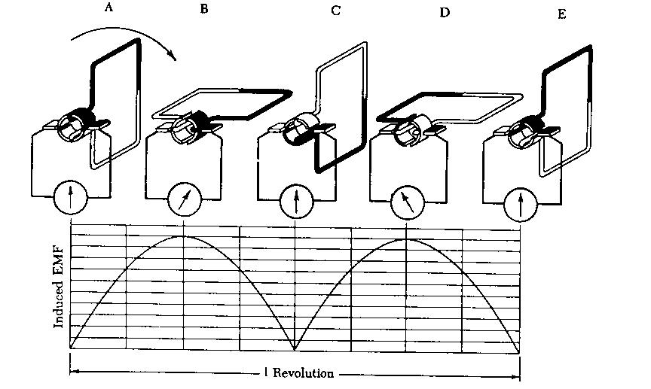
Operation of a basic dc generator

Slide 6
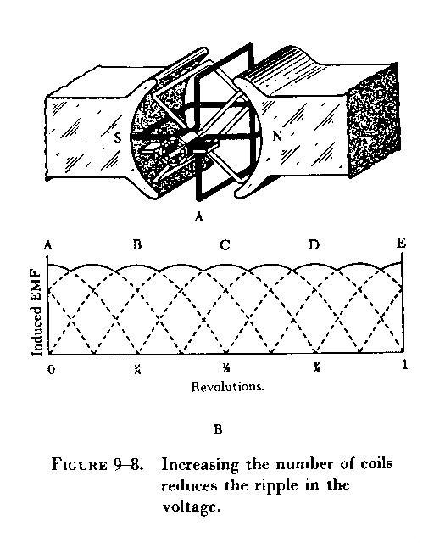
Producing steady dc

